Slide 1
ECOMMERCE DASHBOARD REPORT
KEY FINDINGS FROM THE POWER BI ANALYSIS REPORT FOR THE MANAGEMENT PERUSAL

Slide 2
EXECUTIVE SUMMARY
YTD Sales is 11.53M with a slight difference of 0.83% compare to the PYTD sales.
PYTD is 11.6M
YTD Profits are 1.34M with an increase of 4.50% compared to the previous year.
YTD Quantity sold is 107k with a decrease margin of -7.29% compared to the previous year
YTD Profit Margin is 0.12
Consumer contributed the highest YTD with 5.98M
Home Office contributed the least YTD with 2.05M

Slide 3
SALES PERFORMANCE BY PRODUCT
The top 5 grossing products contributing to the YTD are;
Staple Envelope
Staples
Easy-staple papers
Staples in misc. colors
KI Adjustable-Height Tables
Bottom 5 are;
Eldon Jumbo Profile Portable file Boxes Graphite/White
Lexmark X9575 Professional All-in-one Color Printer
Cisco SPA 525G2 5-Line IP Phone
Xerox Blank Computer Paper
Rediform S.O.S Phone Message Books

Slide 4
CUSTOMER TYPE
Consumer contributed 5.98M to the YTD
Corporate contributed 3.5M
Home Office contributed 2.0M
Therefore, the consumer is the highest contributor to the YTD with sales of 5.98M

Slide 5
Customer Region's analysis
The Western region had the highest YTD of 3.72M
Eastern region had 3.27M
Central had 2.67M
The Southern region contributed the least of 1.67M
Therefore, the western region of the United States contributed significantly to the YTD Sales with a figure of 3.72M

Slide 6
Sales by LOGISTIC type
Standard shipping type contributed the highest of 6.98M to the YTD
Second class shipping is 2.2M
First-class shipping type is 1.7M
Same-day shipping type contributed the least of 596K to the YTD.
Therefore, standard shipping type remained the most preferred and efficient logistic type, contributing 60.5% to the YTD

Slide 7
RECOMMENDATIONS
The company recorded YTD profits despite a record reduction in YTD Sales and YTD Quantity Sold. Efforts should be directed towards distributing highest grossing products and customer segments
The states with the highest customer YTD Sales include California, New York, and Texas. While the states with the least YTD Sales include Wyoming, West Virginia, Columbia, Vermont, etc. The management should endeavour to provide products that are preferred in the states with the highest customer base, while also exploring avenues to strengthen other products that are least purchased.
I suggest that the management should conduct a contextual analysis to identify barriers in the states with the least YTD sales and adapt lessons from states with high YTD sales to the least performing states if it’s suitable.
The management should re-strategise regarding the shipping type for some of the low YTD sales products, especially Eldon Jumbo Profile Portable file Boxes Graphite/White, as it seems as though the logistic types contribute to their low performance.
The management should invest more in the products with high YTD sales to foster customer retention.

Slide 8
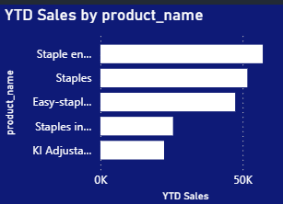
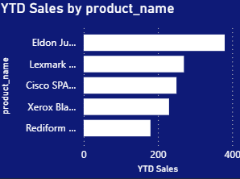
HIGHEST AND LOWEST YTD SALES BY PRODUCTS

Slide 9
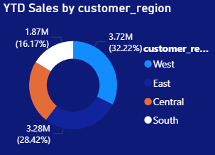
CUSTOMER REGION CHART

Slide 10
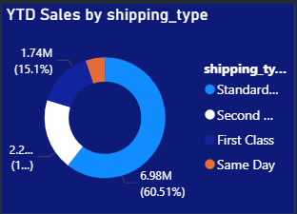
SHIPPING TYPE CHART

